Slide 1
MUNICIPAL CORPORATION MANAGEMENT SYSTEM

Slide 2
TABLE NAME: ADMIN
FIELD | DATA TYPE | SIZE | CONSTRAINT
admin id | Int | 10 | Primary key
Admin name | Varchar | 30 | Not null
Admin mobile | int | 10 | Not null
Username | Varchar | 20 | Not null
Password | Varchar | 20 | Not null
address | Varchar | 30 | Not null

Slide 3
TABLE NAME: CITIZEN
FIELD | DATA TYPE | SIZE | CONSTRAINT
Citizen id | Int | 10 | Primary key
First name | Varchar | 20 | Not null
Last name | Varchar | 20 | Not null
Mobile | Int | 10 | Not null
Username | Varchar | 15 | Not null
Password | Varchar | 15 | Not null
Full address | Varchar | 50 | Not null
City | Varchar | 10 | Not null
State | Varchar | 10 | Not null
Pin code | Int | 6 | Not null

Slide 4
TABLE NAME: COMPLAINT
FIELD | DATA TYPE | SIZE | CONSTRAINT
Complaint id | Int | 10 | Primary key
Citizen id | Int | 10 | Foreign key
Mobile | Int | 10 | Not null
Complaint | Varchar | 50 | Not null
Full address | Varchar | 30 | Not null
Complaint reason | Varchar | 20 | Not null
Current status | Varchar | 10 | Not null

Slide 5
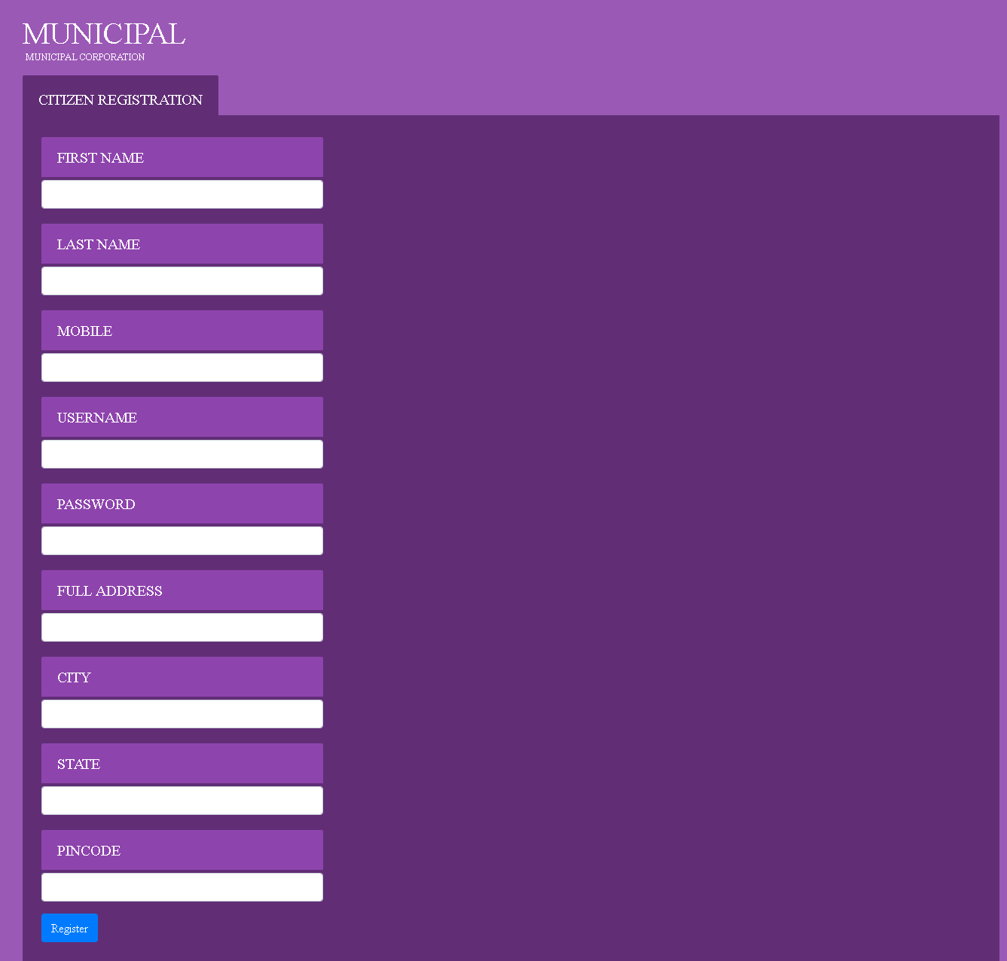

Slide 6
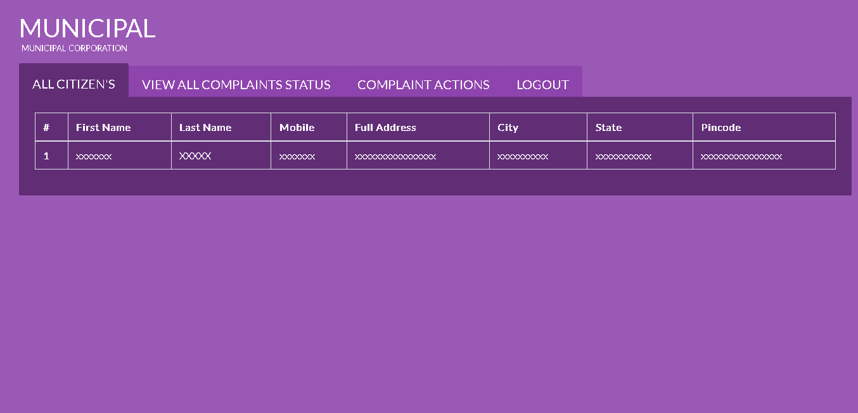

Slide 7
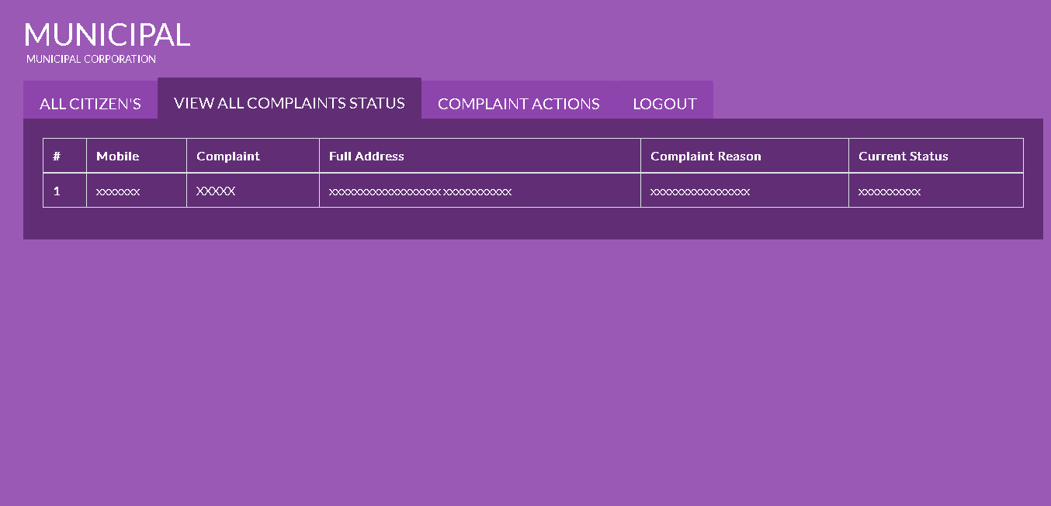

Slide 8
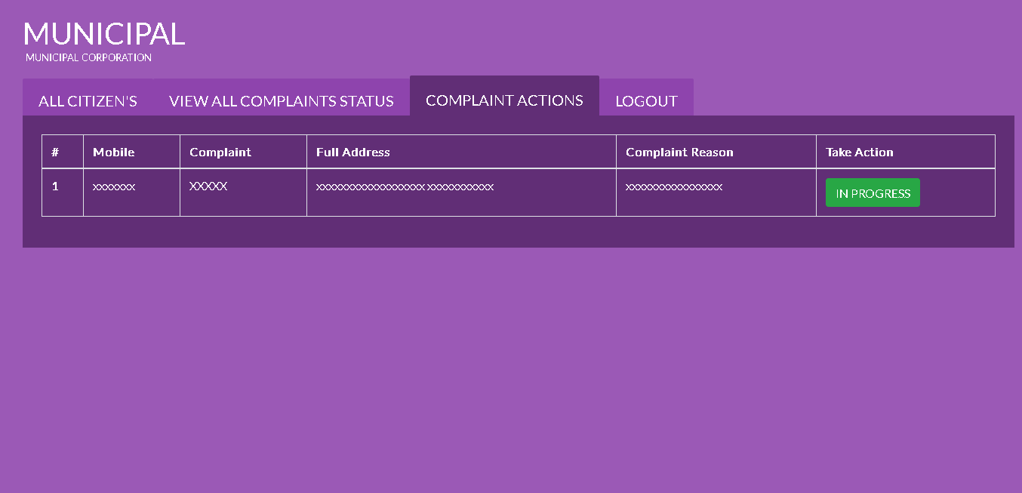

Slide 9


Slide 10
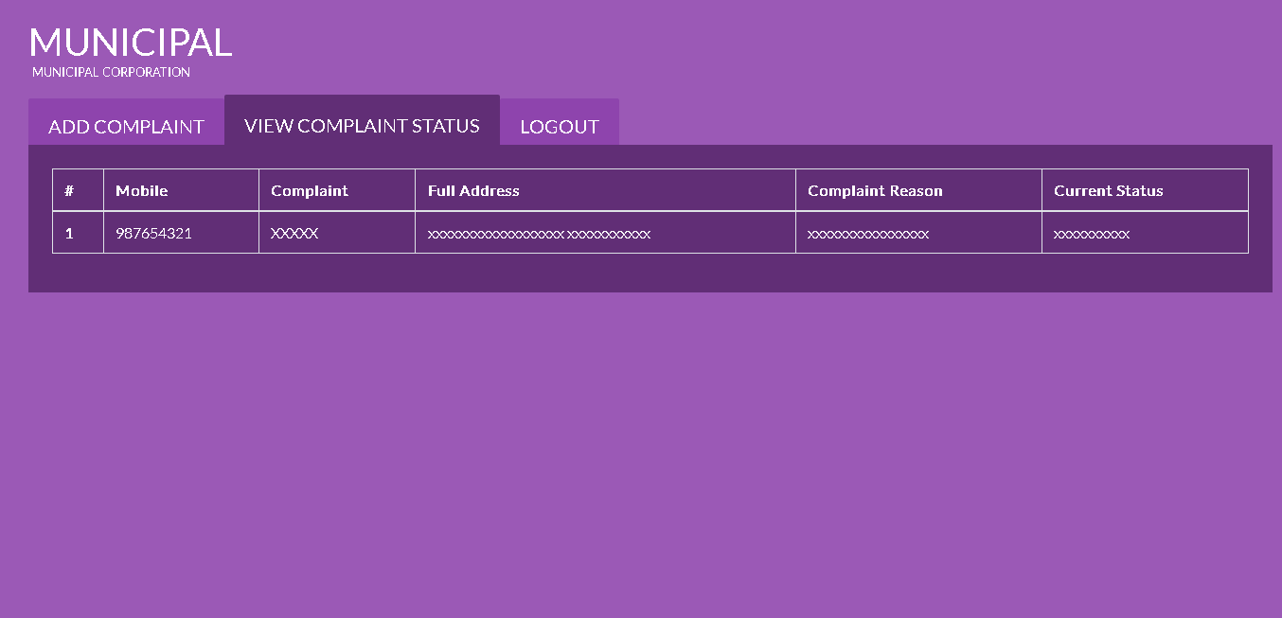

Slide 11
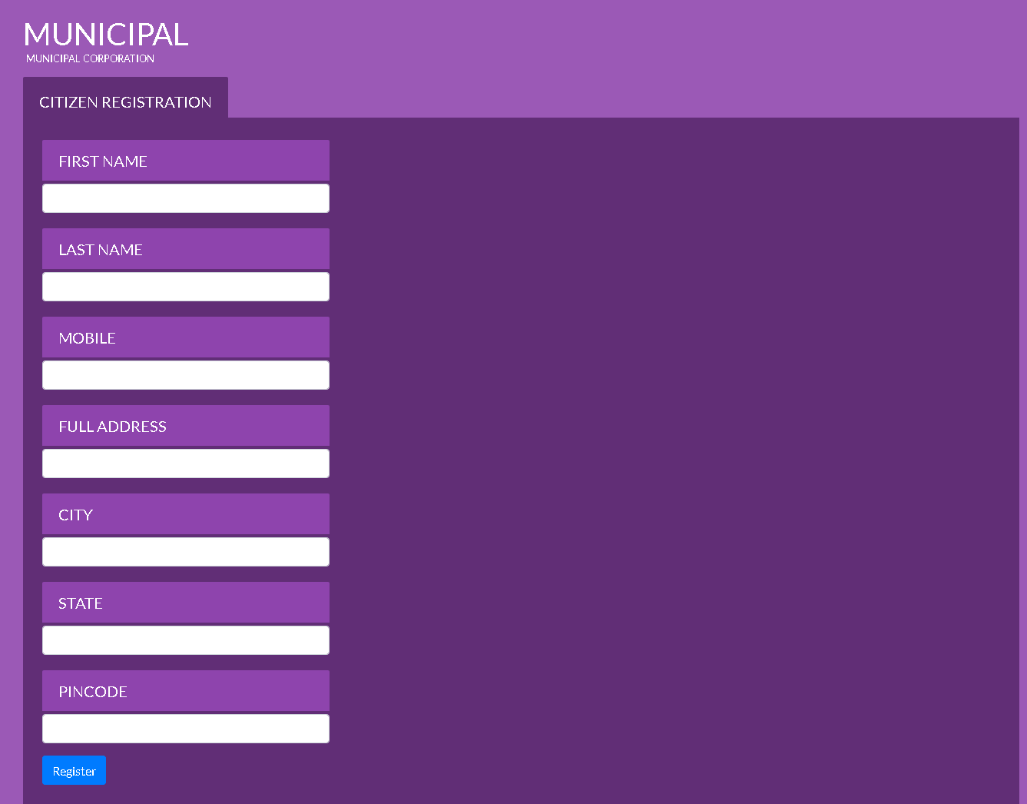

Slide 12
Thank You

